Slide 1
Chapter 2
Finite Automata

Slide 2
FA with ε-Transitions
We can allow explicit ε-transitions in finite automata
i.e., a transition from one state to another state without consuming any additional input symbol
Explicit ε-transitions between different states introduce non-determinism.
Makes it easier sometimes to construct NFAs

Slide 3
FA with ε-Transitions
Definition: ε -NFAs are those NFAs with at least one explicit ε-transition defined.
A = {Q, ∑ , δ, q₀,F }
Sates Q
∑
ε -NFAs have one more column in their transition table
Q₀
F

Slide 4
Example #1 : ε-NFA
L = {w | w is decimal number consisting of }
An optional + or – sign
String of digits
A decimal point
Another string of digits , either (2) or (4) can be empty
0,1,..,9
0,1,..,9
start
ε,+,-
q₁
.
0,1,..,9
ε
q₀
q₂
q₃
q₅
0,1,..,9
.
q₄
A = {{q_{0,} q_{1,} q_{2,} q_{3,} q_{4,} q₅}, {.,0,1,…,9}, δ , q₀, {q₅}}

Slide 5
Example #2 : ε-NFA
ε-NFA recognize the words web and ebay
1
w
2
e
3
b
4
∑
ε
start
9
ε
0
e
5
b
6
a
7
y
8

Slide 6
Example #3 : ε-NFA
Build a NFA for the following language: L = { w | w is a binary string where the last symbol is 0 or that contains only 1’s}
A
ε
B
ε
C
0
D
1
0, 1

Slide 7
Example #4 : ε-NFA
Build a NFA for the following language: L = { w | w is a binary string that have either the number of 0’s odd, or the number of 1’s not a multiple of 3, or both.}
1
0
1
ε
0
start
0
1
ε
1
0
1
0

Slide 8
ECLOSE(q)
L = {w | w is empty, or if non-empty will end in 01}
0,1
q₀
0
q₁
1
q₂
ε
ε-closure of a state q, ECLOSE(q), is the set of all states (including itself) that can be reached from q by repeatedly making an arbitrary number of ε-transitions.
start
q’₀
δ_{E} | 0 | 1 | ε
*q’₀ | Ø | Ø | {q’₀,q₀}
q₀ | {q₀,q₁} | {q₀} | {q₀}
q₁ | Ø | {q₂} | {q₁}
*q₂ | Ø | Ø | {q₂}
ECLOSE(q’₀)
ECLOSE(q₀)
ECLOSE(q₁)
ECLOSE(q₂)

Slide 9
Example : ECLOSE(q)
ECLOSE(1) = {1,2,3,4,6}
ECLOSE(2) = {2,3,6}
ECLOSE(3) = {3,6}
ECLOSE(6) = {6}

Slide 10
Example of compute δ (q_{0, w} )
0,1,..,9
0,1,..,9
start
q₀
ε,+,-
q₁
.
q₂
0,1,..,9
q₃
ε
q₅
w=5.6
0,1,..,9
.
δ (q₀, 5.6)
δ (q₀, ε) = ECLOSE(q₀) = {q₀ , q₁}
δ (q₀, 5) = δ (q₀, 5) U δ (q₁, 5) = {q₁ , q₄}
= ECLOSE(q₁) U ECLOSE(q₄) = {q₁} U {q₄} = {q₁ , q₄}
δ (q₀, 5.) = δ (q₁, .) U δ (q₄, .) = {q₂} U {q₃} = {q₂,q₃}
= ECLOSE(q₂) U ECLOSE(q₃) = {q₂} U {q₃ , q₅} = {q₂ ,q₃ , q₅}
δ (q₀, 5.6) = δ (q₂, 6) U δ (q₃, 6) U δ (q₅, 6) = {q₃} U {q₃} U ∅= {q₃}
= ECLOSE(q₃) {q₃ , q₅}
q₄
L(E) = { w | δ(q₀,w) ∩ F ≠ Φ }

Slide 11
Example : Simulate w
To simulate any transition: Step 1) Go to all immediate destination states.
Step 2) From there go to all their ε-closure states as well.
L = {w | w is empty, or if non-empty will end in 01}
0,1
Simulate for w=101:
q₀
0
q₁
1
q₂
ε
q₀’
ε
ε
start
q’₀
q₀’
q₀
1
1
δ_{E} | 0 | 1 | ε
*q’₀ | Ø | Ø | {q’₀,q₀}
q₀ | {q₀,q₁} | {q₀} | {q₀}
q₁ | Ø | {q₂} | {q₁}
*q₂ | Ø | Ø | {q₂}
Ø
q₀
x
0
0
ECLOSE(q’₀)
q₁
q₀
ECLOSE(q₀)
1
1
q₂
q₀

Slide 12
Example : Simulate w
0,1
Simulate for w=101:
?
q₀
0
q₁
1
q₂
ε
ε
1
start
q’₀
q₃
δ_{E} | 0 | 1 | ε
*q’₀ | Ø | Ø | {q’₀,q₀,q₃}
q₀ | {q₀,q₁} | {q₀} | {q_{0,}q₃}
q₁ | Ø | {q₂} | {q₁}
*q₂ | Ø | Ø | {q₂}
q₃ | Ø | {q₂} | {q₃}

Slide 13



Example ε-NFA
What is the language represented by the following ε-NFA
start
P
ε
ε
Q
R
a
a
a
$$Q_{1}$$
$$R_{1}$$
a
a
$$R_{2}$$
L(ε-NFA) = {w|w ???}

Slide 14



Example ε-NFA : ECLOSE (q)
ECLOSE(P) = ?
ECLOSE(R) = ?
ECLOSE(Q) = ?
ECLOSE(Q1) = ?
ECLOSE(S) = ?
ECLOSE(R1) = ?
ECLOSE(R2) = ?
start
P
ε
ε
Q
R
a
a
ε
a
$$Q_{1}$$
$$R_{1}$$
S
a
a
$$R_{2}$$

Slide 15
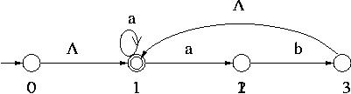
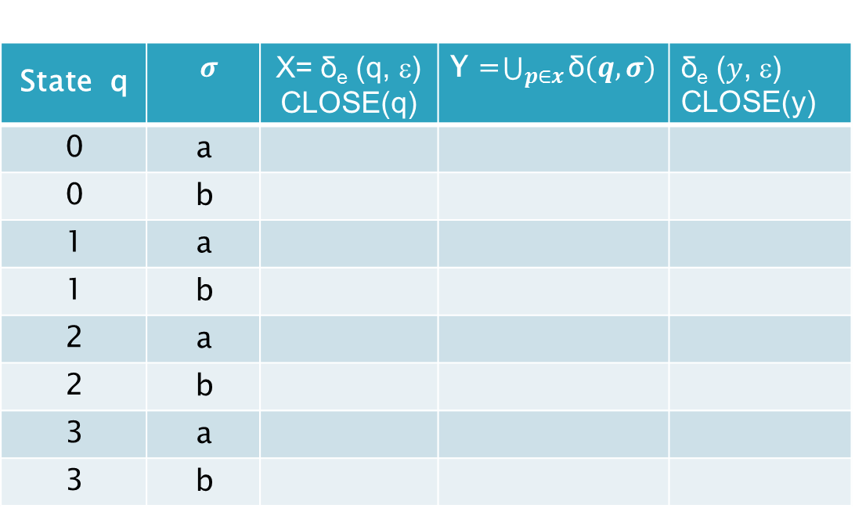
Example #1 : Convert ε-NFA to NFA
ε
ε
∅ U {1, 2}
δ_{e} ($y$, ε) CLOSE(y) | Y =$\bigcup_{p∈x}{\text{δ}(q,σ)}$ | X= δ_{e} (q, ε) CLOSE(q) | $$σ$$ | State q
 |  |  | a | 0
 |  |  | b | 0
 |  |  | a | 1
 |  |  | b | 1
 |  |  | a | 2
 |  |  | b | 2
 |  |  | a | 3
 |  |  | b | 3
{0, 1}
{1, 2}

Slide 16
Example #1 : Convert ε-NFA to NFA
ε
ε
δ_{e} ($y$, ε) CLOSE(y) | Y =$\bigcup_{p∈x}{\text{δ}(q,σ)}$ | X= δ_{e} (q, ε) CLOSE(q) | $$σ$$ | State q
 |  |  | a | 0
 |  |  | b | 0
 |  |  | a | 1
 |  |  | b | 1
 |  |  | a | 2
 |  |  | b | 2
 |  |  | a | 3
 |  |  | b | 3
*
{0, 1}
{1, 2}
{1, 2}
{0, 1} ∅ ∅
*
{1} {1,2} {1,2}
{1} ∅ ∅
{2} ∅ ∅
{2} {3} {1,3}
*
{1,3} {1,2} {1,2}
{1, 3} ∅ ∅

Slide 17
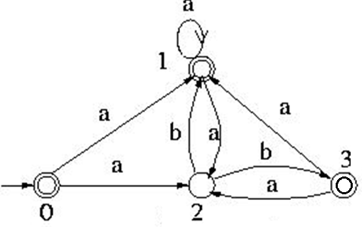
Example #1 : Convert ε-NFA to NFA

Slide 18
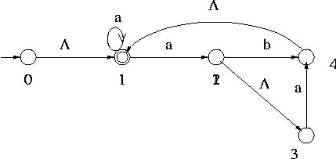
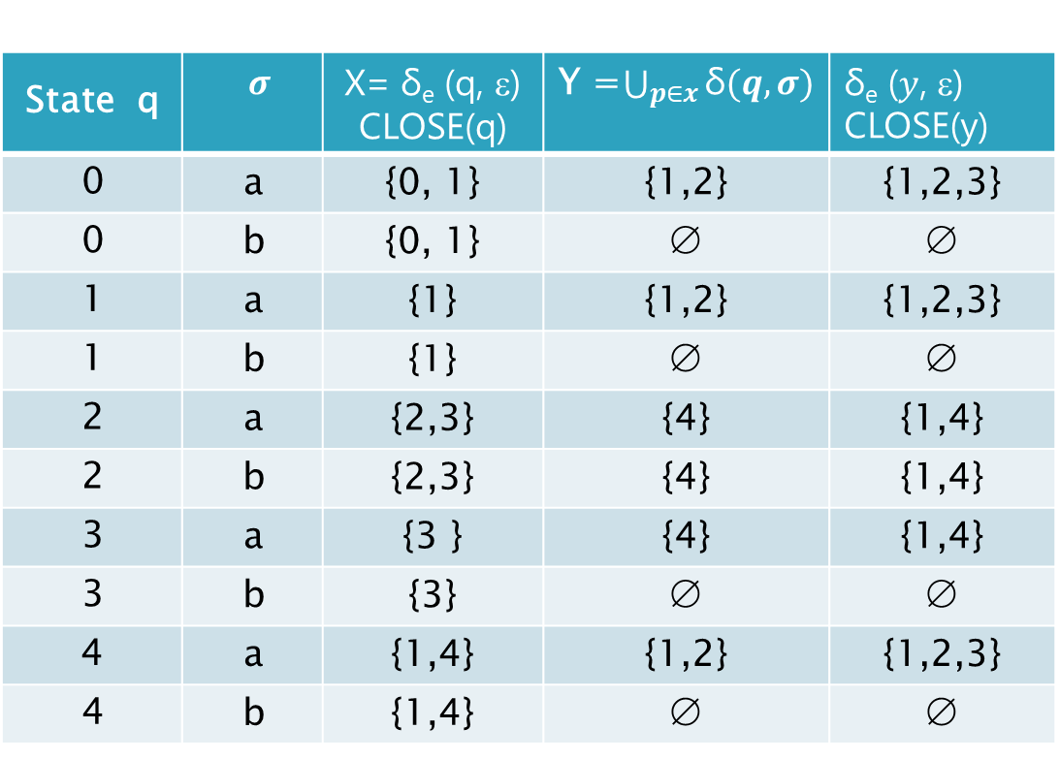
Example #2 : Convert ε-NFA to NFA
ε
ε
ε
δ_{e} ($y$, ε) CLOSE(y) | Y =$\bigcup_{p∈x}{\text{δ}(q,σ)}$ | X= δ_{e} (q, ε) CLOSE(q) | $$σ$$ | State q
{1,2,3} | {1,2} | {0, 1} | a | 0
∅ | ∅ | {0, 1} | b | 0
{1,2,3} | {1,2} | {1} | a | 1
∅ | ∅ | {1} | b | 1
{1,4} | {4} | {2,3} | a | 2
{1,4} | {4} | {2,3} | b | 2
{1,4} | {4} | {3 } | a | 3
∅ | ∅ | {3} | b | 3
{1,2,3} | {1,2} | {1,4} | a | 4
∅ | ∅ | {1,4} | b | 4
*
*
*

Slide 19
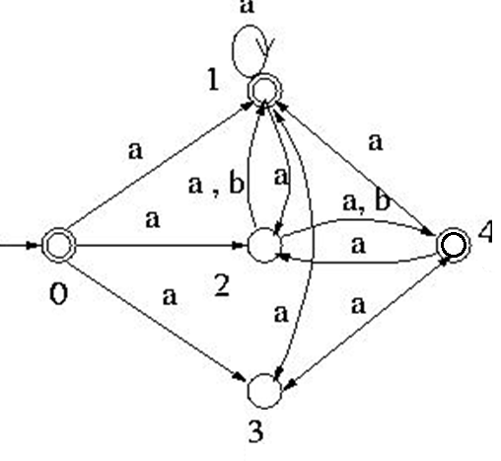
Example #2 : Convert ε-NFA to NFA

Slide 20
Example #3 : Convert ε-NFA to NFA

Slide 21
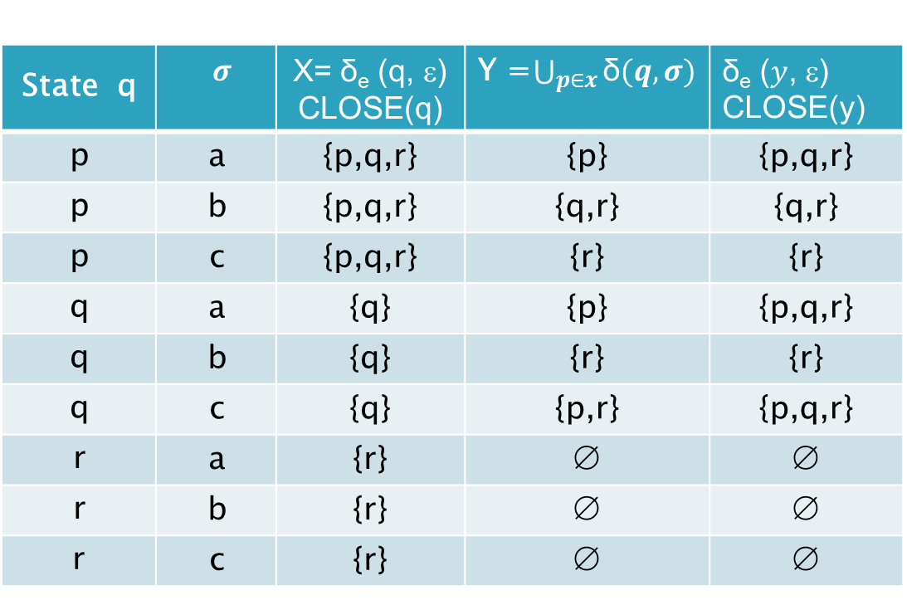
Example #3 : Convert ε-NFA to NFA
δ_{e} ($y$, ε) CLOSE(y) | Y =$\bigcup_{p∈x}{\text{δ}(q,σ)}$ | X= δ_{e} (q, ε) CLOSE(q) | $$σ$$ | State q
{p,q,r} | {p} | {p,q,r} | a | p
{q,r} | {q,r} | {p,q,r} | b | p
{r} | {r} | {p,q,r} | c | p
{p,q,r} | {p} | {q} | a | q
{r} | {r} | {q} | b | q
{p,q,r} | {p,r} | {q} | c | q
∅ | ∅ | {r} | a | r
∅ | ∅ | {r} | b | r
∅ | ∅ | {r} | c | r
*
*

Slide 22
Example #3 : Convert ε-NFA to NFA
a,c
a, c
q
.
a
a, b
a,b,c
start
P
.
r
a, b, c

Slide 23
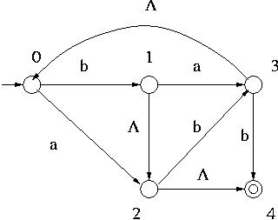
Exercise # 1 Convert ε-NFA to NFA
ε
ε
ε

Slide 24
Eliminating ε-transitions
Given an ε-NFA N, this construction produces an NFA N' such that L(N')=L(N).
The construction of N' begins with N as input, and takes 3 steps:
Make p an accepting state of N' iff ECLOSE(p) contains an accepting state of N.
Add an arc from p to q labeled a iff there is an arc labeled a in N from some state in ECLOSE(p) to q.
Delete all arcs labeled ε.

Slide 25






Eliminating ε-transitions example
N
N’
start
start
P
P
ε
ε
ε
ε
Q
R
Make p an accepting state of N' iff ECLOSE(p) contains an accepting state of N.
Q
a
a
R
a
a
a
$$Q_{1}$$
$$R_{1}$$
a
$$Q_{1}$$
$$R_{1}$$
a
a
a
a
$$R_{2}$$
$$R_{2}$$

Slide 26



Eliminating ε-transitions example
N
N’
start
start
P
P
a
ε
ε
ε
ε
Add an arc from p to q labeled a iff there is an arc labeled a in N from some state in ECLOSE(p) to q.
a
Q
R
Q
R
a
a
a
a
a
a
$$Q_{1}$$
$$R_{1}$$
$$Q_{1}$$
$$R_{1}$$
a
a
a
a
$$R_{2}$$
$$R_{2}$$

Slide 27






Eliminating ε-transitions example
N
N’
start
start
P
P
a
ε
ε
a
a
a
Q
R
Q
R
a
a
a
a
a
Delete all arcs labeled ε.
a
$$Q_{1}$$
$$R_{1}$$
$$Q_{1}$$
$$R_{1}$$
a
a
a
a
$$R_{2}$$
$$R_{2}$$

Slide 28



Eliminating ε-transitions example
start
P
a
a
$$R_{1}$$
$$Q_{1}$$
a
a
a
$$R_{2}$$
a
a
Q
R

Slide 29
Equivalency of DFA, NFA, ε-NFA
Theorem: A language L is accepted by some ε-NFA if and only if L is accepted by some DFA
Implication:
DFA ≡ NFA ≡ ε-NFA
(all accept Regular Languages)

Slide 30
Equivalency of DFA, NFA, ε-NFA
Use subset construction to convert NFA to DFA
0,1,..,9
0,1,..,9
start
ε,+,-
q₁
.
0,1,..,9
ε
q₀
q₂
q₃
q₅
0,1,..,9
.
q₄

Slide 31
Equivalency of DFA, NFA, ε-NFA
E= {Q_{E}, ∑ , δ_{E} q₀ , F_{E}}
D= {Q_{D}, ∑ , δ_{D} , q_{D}, F_{D}}
We shall find all accessible state of D are e-closed subset of Q_{E}
q_{D} = ECLOSE(q₀)
F_{D} set of sates contain at least one accepting state of E
δ_{D} is computed for all a in ∑ and set S in Q_{D}

Slide 32
Equivalency of DFA, NFA, ε-NFA

Slide 33
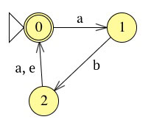
Example # 1 Convert ε-NFA to DFA

Slide 34
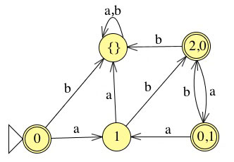
Example # 1 Convert ε-NFA to DFA

Slide 35
Exercise # 1 Convert ε-NFA to DFA
Convert the following ε-NFA to the equivalent DFA
ε
start
ε
a
ε
b
ε
1
2
3
4
5
6
ε

Slide 36
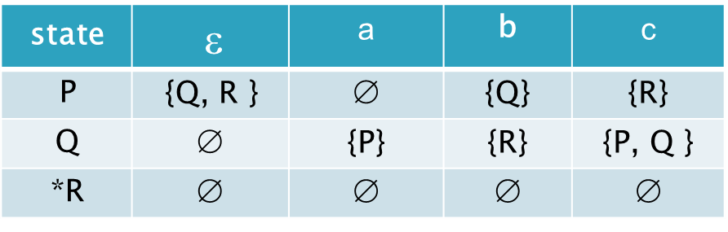
Exercise # 2 Convert ε-NFA to DFA
Convert the following ε-NFA to the equivalent DFA
c | b | a | $$\text{}$$ | state
{R} | {Q} | ∅ | {Q, R } | P
{P, Q } | {R} | {P} | ∅ | Q
∅ | ∅ | ∅ | ∅ | *R

